Slide 1

Capstone Project - The Battle of Neighborhoods
Selecting the best location to open a Vegan SUSHI BAR in Manhattan, New York by Amitha Dhewi

Slide 2
Introduction/Business Problem
The City of New York, is the most populated city in the United States. It is diverse and is the financial capital of USA and is multicultural. It provides lot of business opportunities and business friendly environment as well as has attracted many different players into the market. It is also a global hub of business and commerce.
The city is a major center for banking and finance, retailing, world trade, transportation, tourism, real estate, new media, traditional media, advertising, legal services, accountancy, insurance, theater, fashion, and the arts among others in the United States. This also means that the market is severely competitive. As it is highly developed city so cost of doing business is also one of the highest. Thus, any new business venture or expansion needs to be analyzed very carefully.
The insights derived from these analysis will give a better understanding of the business environment which in return would help in strategically targeting the market. This will also aid in the reduction of risk and therefore, the Return on Investment will be reasonable.

Slide 3
Business Problem
My Stakeholder wants to open her business in Manhattan area, therefore I have only focus on that borough during my analysis. We define potential neighborhood based on the number of sushi bars which are operating right in each neighborhood.
Manhattan has full potential but also is a very challenging district to open a business because of high competition. The new vegan sushi bar should be open in an area that has inadequate neighborhood, in this way, the bar can attract more customers.
Therefore, this analysis necessary to ensure that we have enough customers and that we are not so close to other sushi places.

Slide 4

Data Selection Assumption for the project is that every regular sushi place in New York is a Vegan sushi place.
To identify the characteristics of our competitors' venues in Manhattan, we would first need to find out the number of sushi bars that are in Manhattan currently and note their location.
We then used Google Map API to find their geographic coordinates based on their postal code addresses.
In Manhattan, there are 1763 sushi bars that are currently operating.

Slide 5
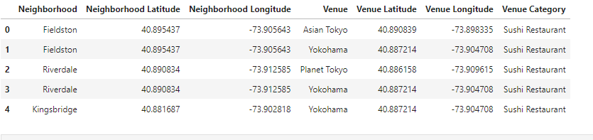
Data Selection
Next, we used Google Map API to find the geographic coordinates for the 5 locations shortlisted for our vegan sushi bar:
Table 2: Data frame containing geographic coordinates of our 5 shortlisted locations

Slide 6
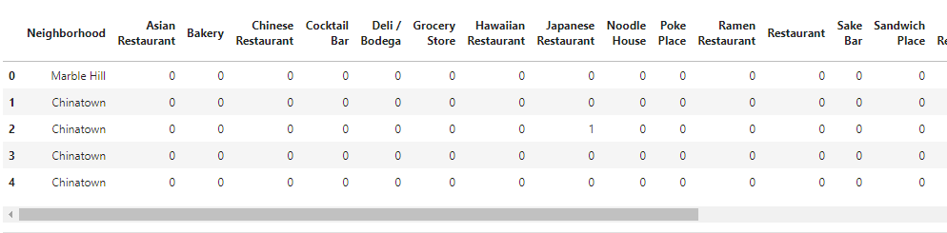
Methodology
The addresses are converted into their equivalent latitude and longitude values.
Foursquare API was used to explore neighborhoods in Manhattan, New York.
Finally, the explore function to get sushi restaurant categories in each neighborhood.

Slide 7
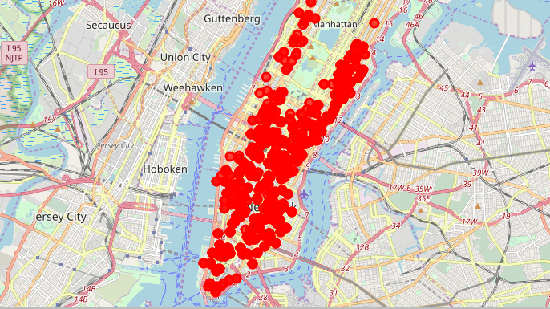
Methodology
Current sushi bars in Manhattan

Slide 8
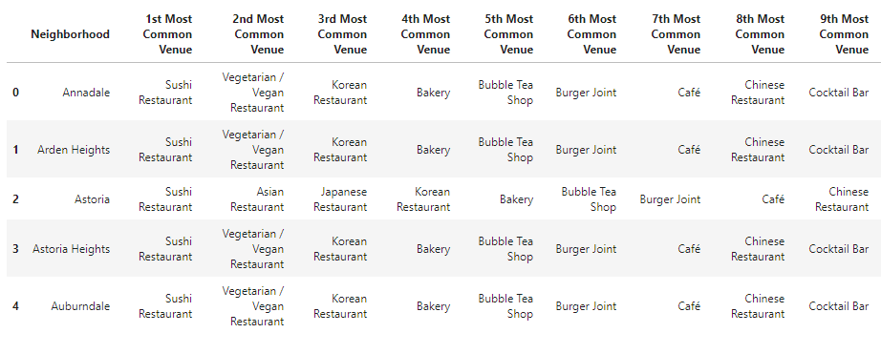
Methodology
Next, by using feature to group the neighborhoods into clusters, the K-means clustering algorithm was used to complete the task.
Folium library is then used to visualize the neighborhoods in Manhattan and its emerging clusters.

Slide 9
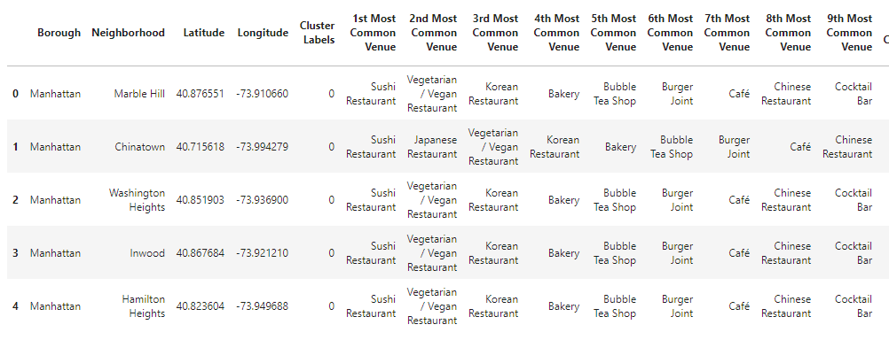
Results
Using K-mean to clustering data area with least number of sushi bars
Cluster 0

Slide 10
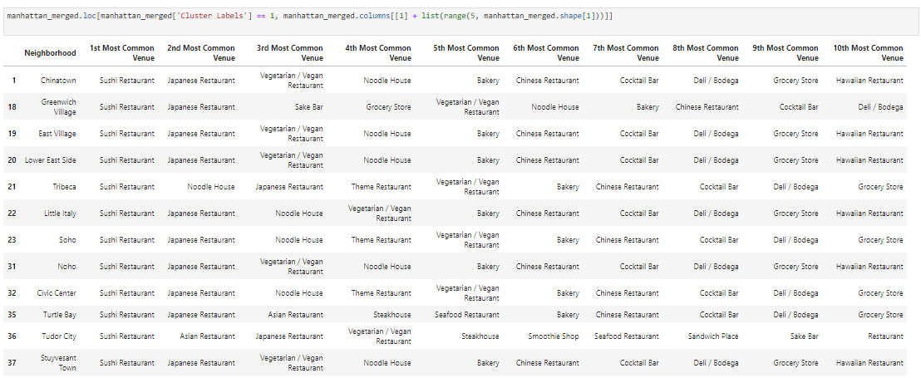
Results
Cluster 1

Slide 11
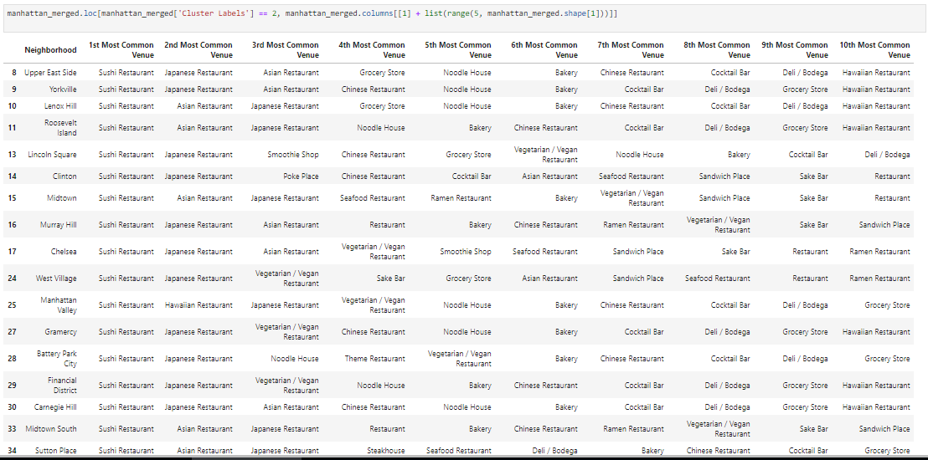
Results
Cluster 2

Slide 12
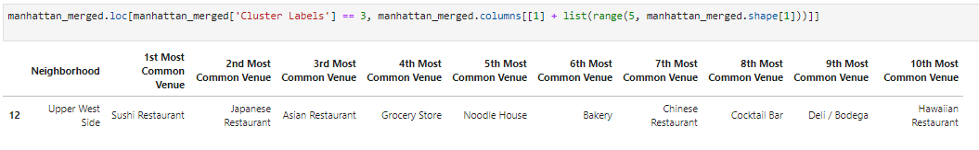
Results
Cluster 3

Slide 13
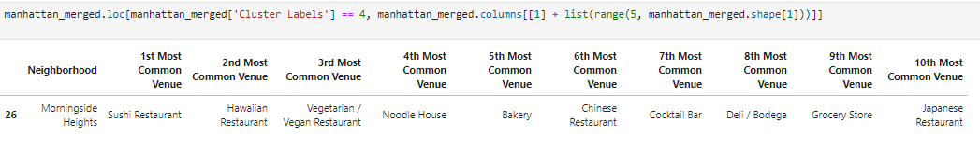
Results
Cluster 4

Slide 14
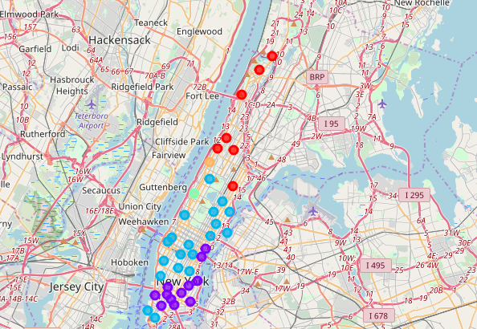
Results Map

Slide 15
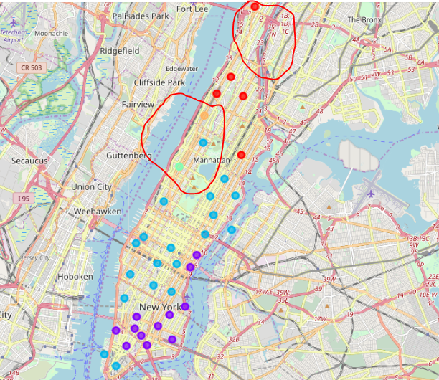
Results
Based on dataframe analysis provided in the slides above, Cluster 3 (The Upper West Side ) and Cluster 4 (The Morningside Heights) areas are the best places to open a new vegan sushi bar venture.

Slide 16
Discussion
The analysis was performed on limited data. This may sway either direction however, as there was a good amount of data is available, there was a scope to produce great results.
There is a very severe competition in Midtown and Soho regions, therefore, I believe that it is very risky to open a new vegan venture in those areas.
However, I would strongly recommend the Central Harlem region as it has great potentials as it is closer to the Morningside Heights area.
This findings and recommendations can be further enhanced by adding a more detailed analysis on other factors such as transportation and demographics of inhabitants in the New York region.

Slide 17
Conclusion
In conclusion, even though all aspects of the goals in this project were met, there is always room for further improvement and development.
However, with the goals of the project being met and, of course with some more detailed work, it could easily be developed into a fully pledged application that could support the opening a business idea in an any unknown location (if not several).

